Slide 1
SIC Task 5
Confusion Matrix

Slide 2
Confusion Matrix
A confusion matrix is a performance evaluation tool used in Machine Learning.
It is mainly used for the classification problems.
It compares the actual values with the predicted values.
It helps to determine how accurately how a model classifies the data.

Slide 3
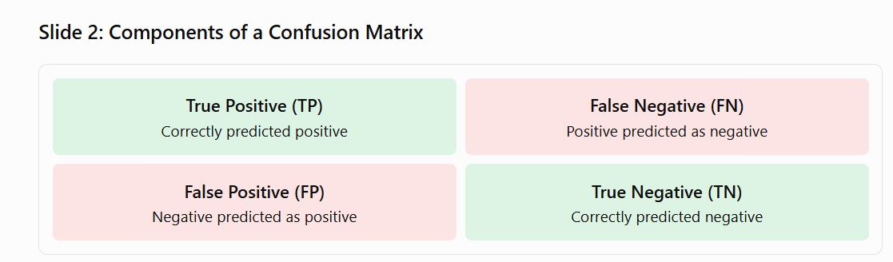
Components of the Confusion Matrix

